Slide 1
AIPING X RHS
Allen Li Hazel Huang Kai Chen May Wen Ning Yu

Slide 2


PROBLEM
STATEMENT
Audience: Plant Managers
Identify the highest operational risks &
bottleneck for batch release
Give prescriptive insights to improve quality and efficiency of batch release

Slide 3

DASHBOARDS

Slide 4
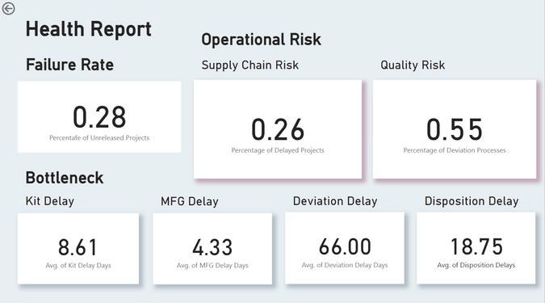
HIGHEST RISK - QUALITY RISK

Slide 5
BOTTLENECK - DEVIATION PROCESS

Slide 6
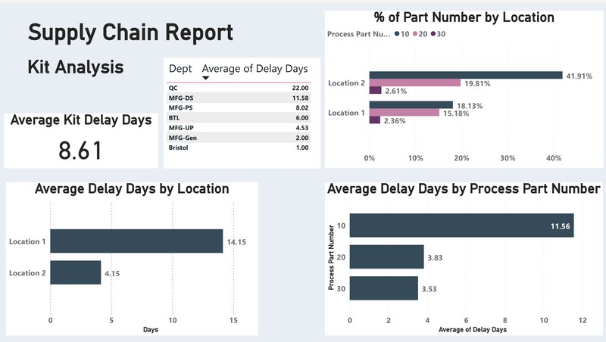
BIGGEST RISK FOR KIT SUPPLY IS LATE DELIVERY
KEY ANALYTICS METRICS
Kits delivery delay time

Slide 7
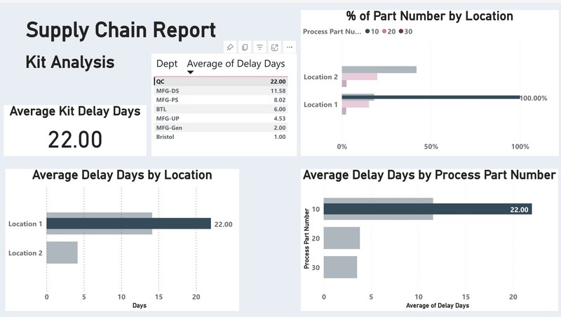
BIGGEST RISK FOR KIT SUPPLY IS LATE DELIVERY
KEY ANALYTICS METRICS
Kits delivery delay time

Slide 8
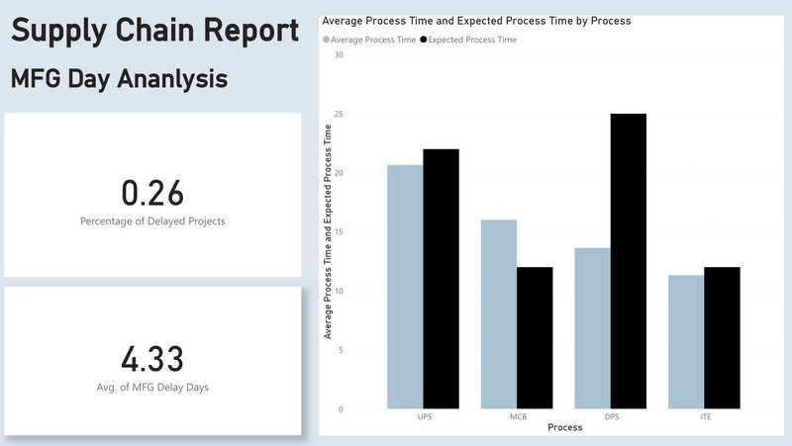
BIGGEST RISK FOR SUPPLY CHAIN IS DELAY IN PRODUCTION PROCESS
KEY ANALYTICS METRICS
Manufacturing process delay time

Slide 9
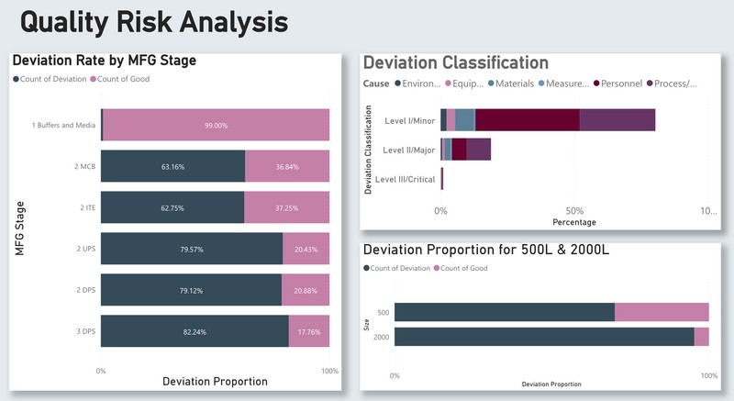
BIGGEST RISK FOR QUALITY
OPERATION IS PROCESS IN DPS
KEY ANALYTICS METRICS
Deviation rate

Slide 10
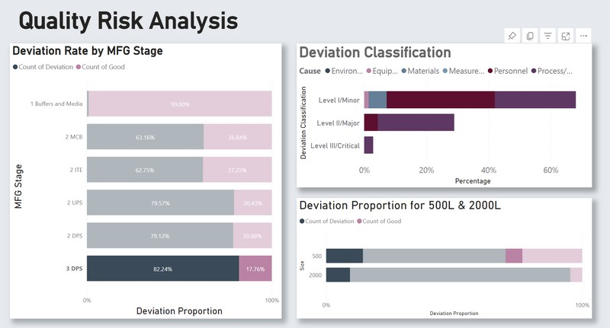
BIGGEST RISK FOR QUALITY
OPERATION IS PROCESS IN DPS
KEY ANALYTICS METRICS
Deviation rate

Slide 11
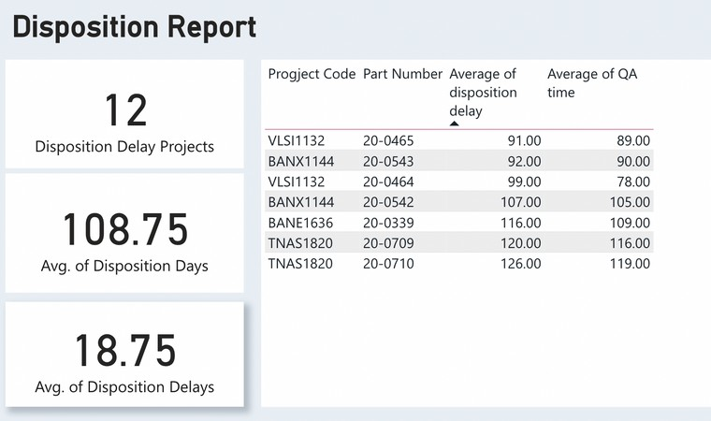
BIGGEST RISK FOR DISPOSITION - QA TIME
KEY ANALYTICS METRICS
Disposition delay time

Slide 12
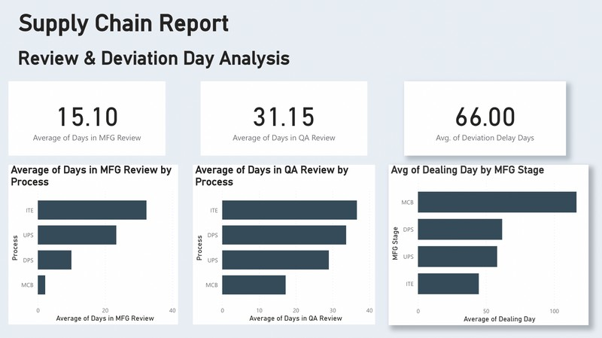
DETAILS FOR REVIEW PROCESS
KEY ANALYTICS METRICS
Review Time Deviation Delay Time

Slide 13
DIVE
DEEPER INTO
Quality Control has the highest risk
55% of the product ran into deviation process
Our bottleneck is deviation process
Deviation has the highest delay time of 66 days
DEVIATION PROCESS
DPS has the highest deivation rate
We suggest setting an SOP for manufacturing process and put more emphasis on personnel training

